Slide 1
Building a Personnel Policy Handbook
Alabama Association of Municipal Clerks and Administrators
July 1, 2021
Presented by Lisa Cooper
Hand Arendall Harrison Sale LLC

Slide 2
Outline
Goals for a Good Employee Handbook
The Nuts and Bolts of a Good Employee Handbook
Key Policies and Pitfalls

Slide 3
An Employee Handbook: What is it?
Collection of all the policies and procedures that an employer has which sets expectations for employees and provides a guide that tells employees how to act in the workplace.

Slide 4
What Makes a Good Employee Handbook?
A good employee handbook:
Provides explicit guidelines but allows for flexibility;
Uses straight forward language and is easy to read; and
Is User-friendly.
Ideally a employee handbook will:
Communicate clearly to employees what is expected of them;
Educate employees on what they can expect from management and leadership; and
Provide employees with clear guidance on how to address any workplace issues.

Slide 5
What’s Inside: Introduction and Disclaimer
Introductory Statement
Explain the purpose of the Handbook
Makes clear that the employee is responsible for reading, understanding, and complying
Disclaimer
Nothing in this handbook creates a contract of employment.
The policies are only guidelines and the City reserves the right to change these policies and work rules at any time without notice.
Employment relationship is at will. (if county or municipal law does not confer a property interest in employment and/or require cause)

Slide 6
What’s Inside: General Policies
Equal Employment Opportunity Policy
Anti-Harassment Policy
Anti-Retaliation Policy
Disability Accommodations Policy
Religious Accommodation Policy

Slide 7
What’s Inside: Ethics and Non-Disclosure Policies
Conflicts of Interest Policy
Government Employees are responsible for adhering to the standards for public employment as adopted by the Alabama Ethics Commission. Ala. Code § 36-25-1, et. seq..
Non-Disclosure Requirements
Policy to protect the confidential information that employees receive and steps that they must take to protect it.

Slide 8
What’s Inside: Employee Compensation and Benefits
Employee Classifications
Full-time or part-time
Classified
Probationary
Payroll and Compensation Policies
Employee responsibilities regarding timekeeping
Overtime Policy (OT policy for police and firefighters)
Compensatory Time Policy
Employee workweeks
Lactation breaks
Benefits

Slide 9
What’s Inside: Leave and Time Off Policies
Official Holidays
Vacation/PTO
Leave
Sick Leave
Parental Leave
FMLA Leave
USERRA
State Military Leave (Ala. Code § 31-2-13)
Jury Duty
Miscellaneous other leave (bereavement, etc.)

Slide 10
What’s Inside: On the Job Policies
Key Goal: Set the expectations for the workplace
Attendance and Punctuality
Remote work
Personal Appearance
Fraternization Policy
Employee Conduct and Work Rules/Discipline
Computer and Internet Usage Policy
Social Media Policy

Slide 11
What’s Inside: Health and Safety
Health and Safety in the workplace policy
Smoke-free workplace policy
Alcohol and Drug Use and Testing policy
Security Inspections/Workplace searches

Slide 12
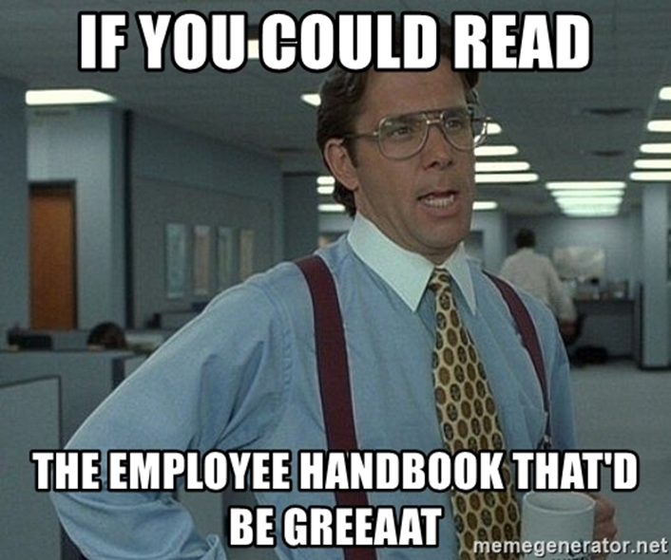
Creating an Employee Handbook – What’s Inside: Employee Acknowledgment Form
Employee receives an acknowledgment form that they sign (physically or electronically)
Record of their receipt and acknowledgement of policies

Slide 13
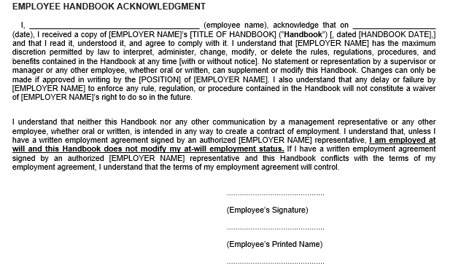
Creating an Employee Handbook –Employee Acknowledgment Form Sample
Notes:
Don’t let your employees do this

Slide 14
Key Policies and Pitfalls
Key Policies
Pitfalls and Trap Doors: Common Mistakes in Creating Handbooks

Slide 15
Key Policies: Equal Opportunity Policies
One of the BEST ways to show you are complying with Federal Law
Employer shall not discriminate under any program, activity, service, employment opportunity or practice on the basis of race, color, religion, sex, national origin, age, disability, or any other characteristic protected by law.
As of June 15, 2020, Sex discrimination includes discrimination against employees based on gender identity and sexual orientation. Bostock v. Clayton Cty., 140 S. Ct. 1731 (2020).

Slide 16
Key Policies: Sample Equal Opportunity Policy

Slide 17
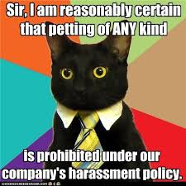
Key Policies: Anti-Harassment
Anti-Harassment
Make clear that you will not tolerate harassment based on or related to sex, race, color, national origin, religion, age, or disability.
Clear reporting instructions
Specific person(s) to handle complaints

Slide 18
Key Policies: Anti-Retaliation
Anti-Retaliation
Make clear that no one will subject to any form of retaliation or reprisal for reports or complaints of discrimination or for cooperating in any investigations.
First Amendment.

Slide 19
Key Policies: Excerpt from an Anti-Harassment Sample Policy

Slide 20
Key Policies: Excerpt from an Anti-Retaliation Sample Policy

Slide 21
Key Policies: Disability Accommodations
Compliance with the Americans with Disabilities Act (ADA), as amended by the ADA Amendments Act (ADAAA).
Commit to provide reasonable accommodations.
Provide details on the interactive process.
Section 504 of the Rehabilitation Act of 1973 may also apply.
Notes:
Both acts State in part that "no otherwise qualified disabled individual shall solely by reason of such disability, be excluded from the participation in, be denied the benefits of, or subjected to discrimination" in programs or activities sponsored by a public entity.

Slide 22
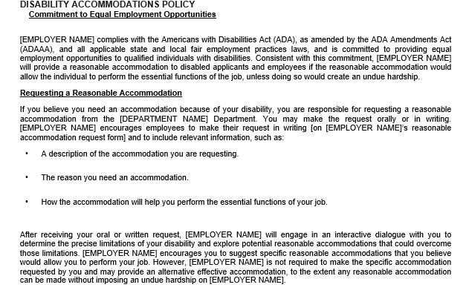
Key Policies: Disability Accommodations Sample Policy
Notes:
Both acts State in part that "no otherwise qualified disabled individual shall solely by reason of such disability, be excluded from the participation in, be denied the benefits of, or subjected to discrimination" in programs or activities sponsored by a public entity.

Slide 23
Key Policies: Discipline
Be Clear about what constitutes a disciplinary offense
Progressive Discipline
At minimum, reserve for the right to administer discipline at any level and any manner that is appropriate

Slide 24
Key Policies: Discipline/Due Process
Due Process Prior to suspensions and terminations
Due Process must be administered prior to the deprivation of a public employee's liberty interest or deprivation of any rights. This includes, demotions, loss of pay, suspensions, or terminations.
Provide steps and instructions for:
Notice
A Hearing
The Issuance of a decision
Appeals
If an employee is placed on leave prior to a due process determination, they may have to be put on paid leave rather than unpaid leave.

Slide 25
Key Policies: Social Media Policy
Social Media Policies
Use of social media must not interfere with an employee's responsibilities
Not speaking for the City
Be mindful of First Amendment
Public employers do not have to tolerate disrespectful, demeaning, rude, and insulting speech.
Recommendations for responsible use
Speech that violates City’s policies

Slide 26
Key Policies: Computer Usage and Internet Policy
Require that any personal, non-business use of an office computer or other communication device or system not interfere with an employee’s job duties and responsibilities.
Limits on permissible uses of work computer or internet at work.
Training policies to ensure cybersecurity protections.

Slide 27
Common Mistake: Failing to Get Buy-in
Stakeholder input/training
City vs department policy

Slide 28
Common Mistake: Overly Prescriptive Policies or Overly Broad Policies
Your handbook needs to provide clear guidance to your employees but it cannot anticipate and prepare for every situation.
An ideal Handbook balances the need for clear guidance with the understanding that convoluted and overly detailed policies regarding distinct situations may not ultimately benefit the employees.

Slide 29
Common Mistake: Your Policy Does Not Match Your Practice
You have a really great Employee Handbook that’s never been used.
This can be problematic because the Employee Handbook can be a great tool in a defense of claims. But, only if its used.

Slide 30
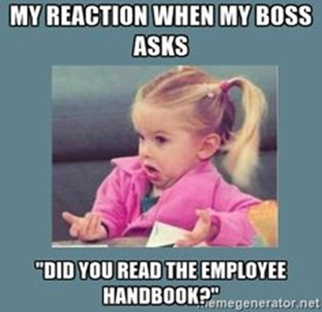
Common Mistake: Lack of Access
Your employee Handbook should be accessible to all employees to ensure that they are aware of the contents and can follow its polices and procedures

Slide 31
Common Mistake: Your Employee Handbook is Set in Stone
The law can change rapidly, and new requirements can be implemented overnight.
You handbook must be reviewed on a regular basis to ensure continued compliance with all applicable laws.
Notes:
Examples
FFCRA
Bostock

Slide 32
Comments? Questions?
Lisa Cooper
(251) 694-6266
LCooper@handfirm.com

